Slide 1
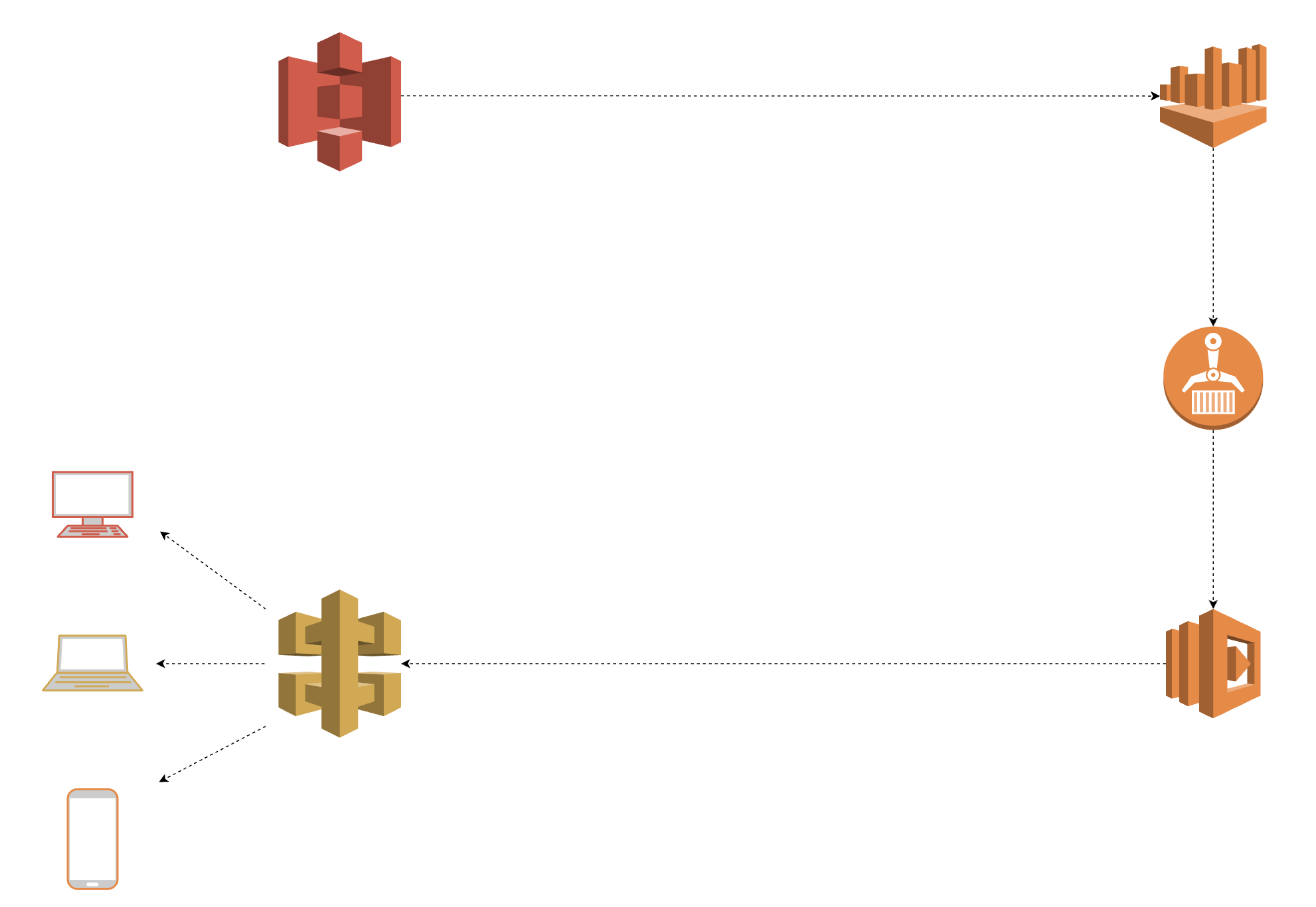
It’s serverless all the way down!
Using serverless technologies to build, deploy, and serve scalable data pipelines

Slide 2

Who has used serverless technologies?

Slide 3
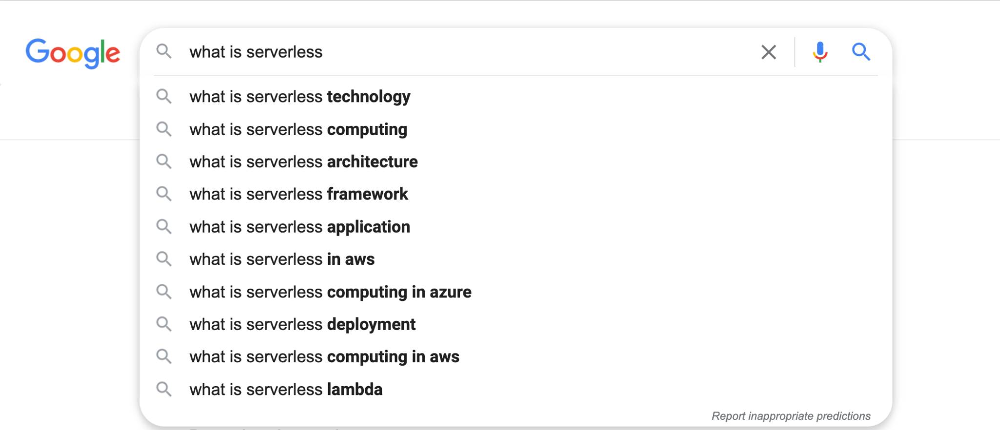

Slide 4
Why go serverless?
Eliminates server maintenance
Only pay for what you use
Inherently and automatically scalable
Easy to deploy

Slide 5
When to go serverless?
Non-constant workload
Volume-varying tasks
Non-low latency requirements
If you’ve asked “how can i meet these requirements with a service that’s always on and available at a low cost?”

Slide 6
When to NOT go serverless?
Low latency responses
High memory computations
Long running tasks
Many tasks interacting with each other and require statefulness
Notes:
https://www.serverless.com/blog/when-why-not-use-serverless
https://pauldjohnston.medium.com/when-not-to-use-serverless-jeff-6d054d0e7098

Slide 7
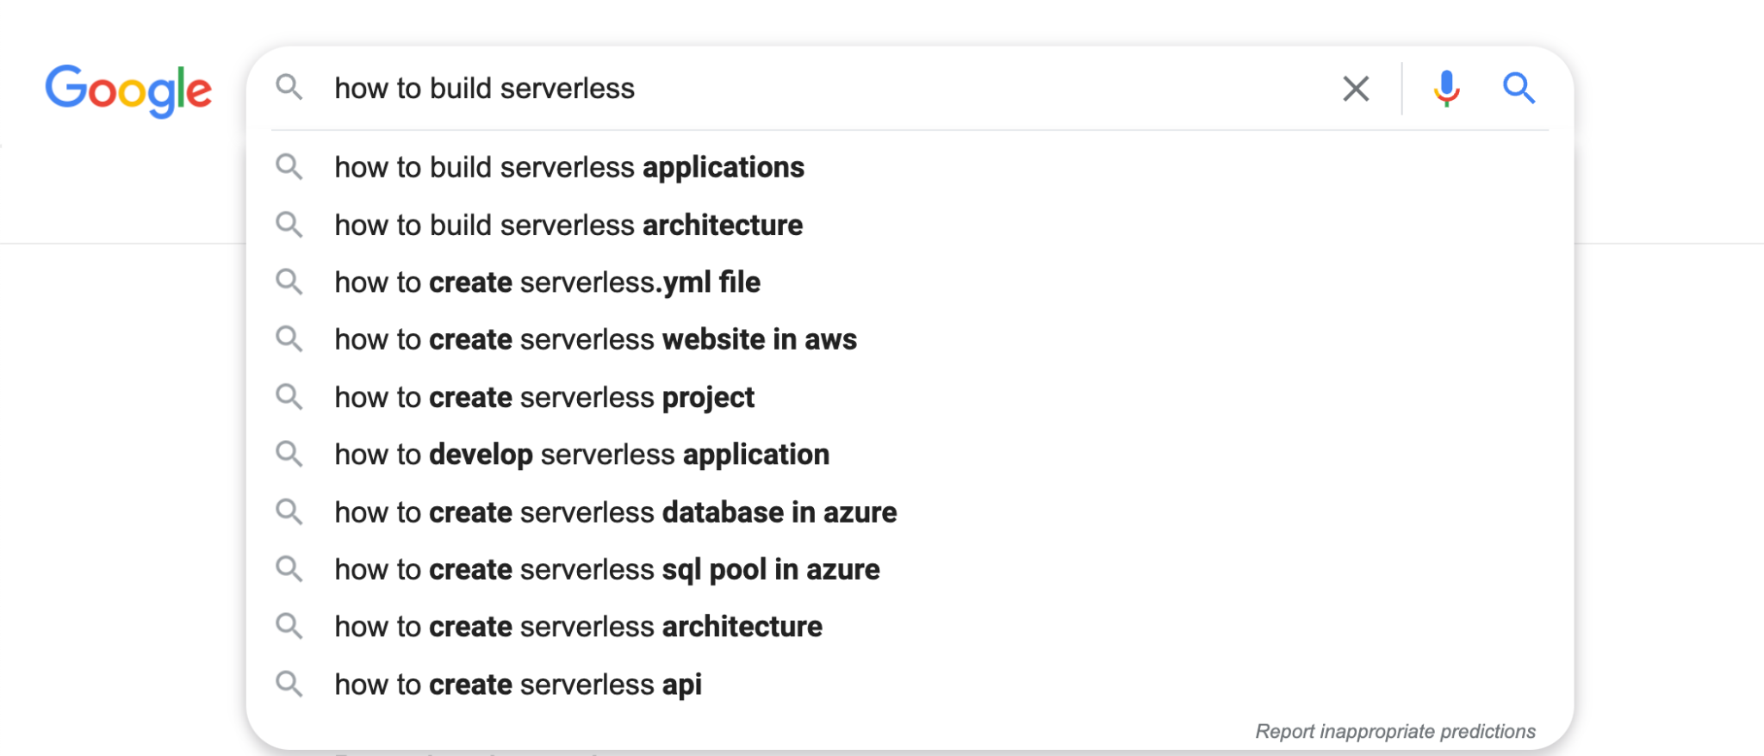

Slide 8
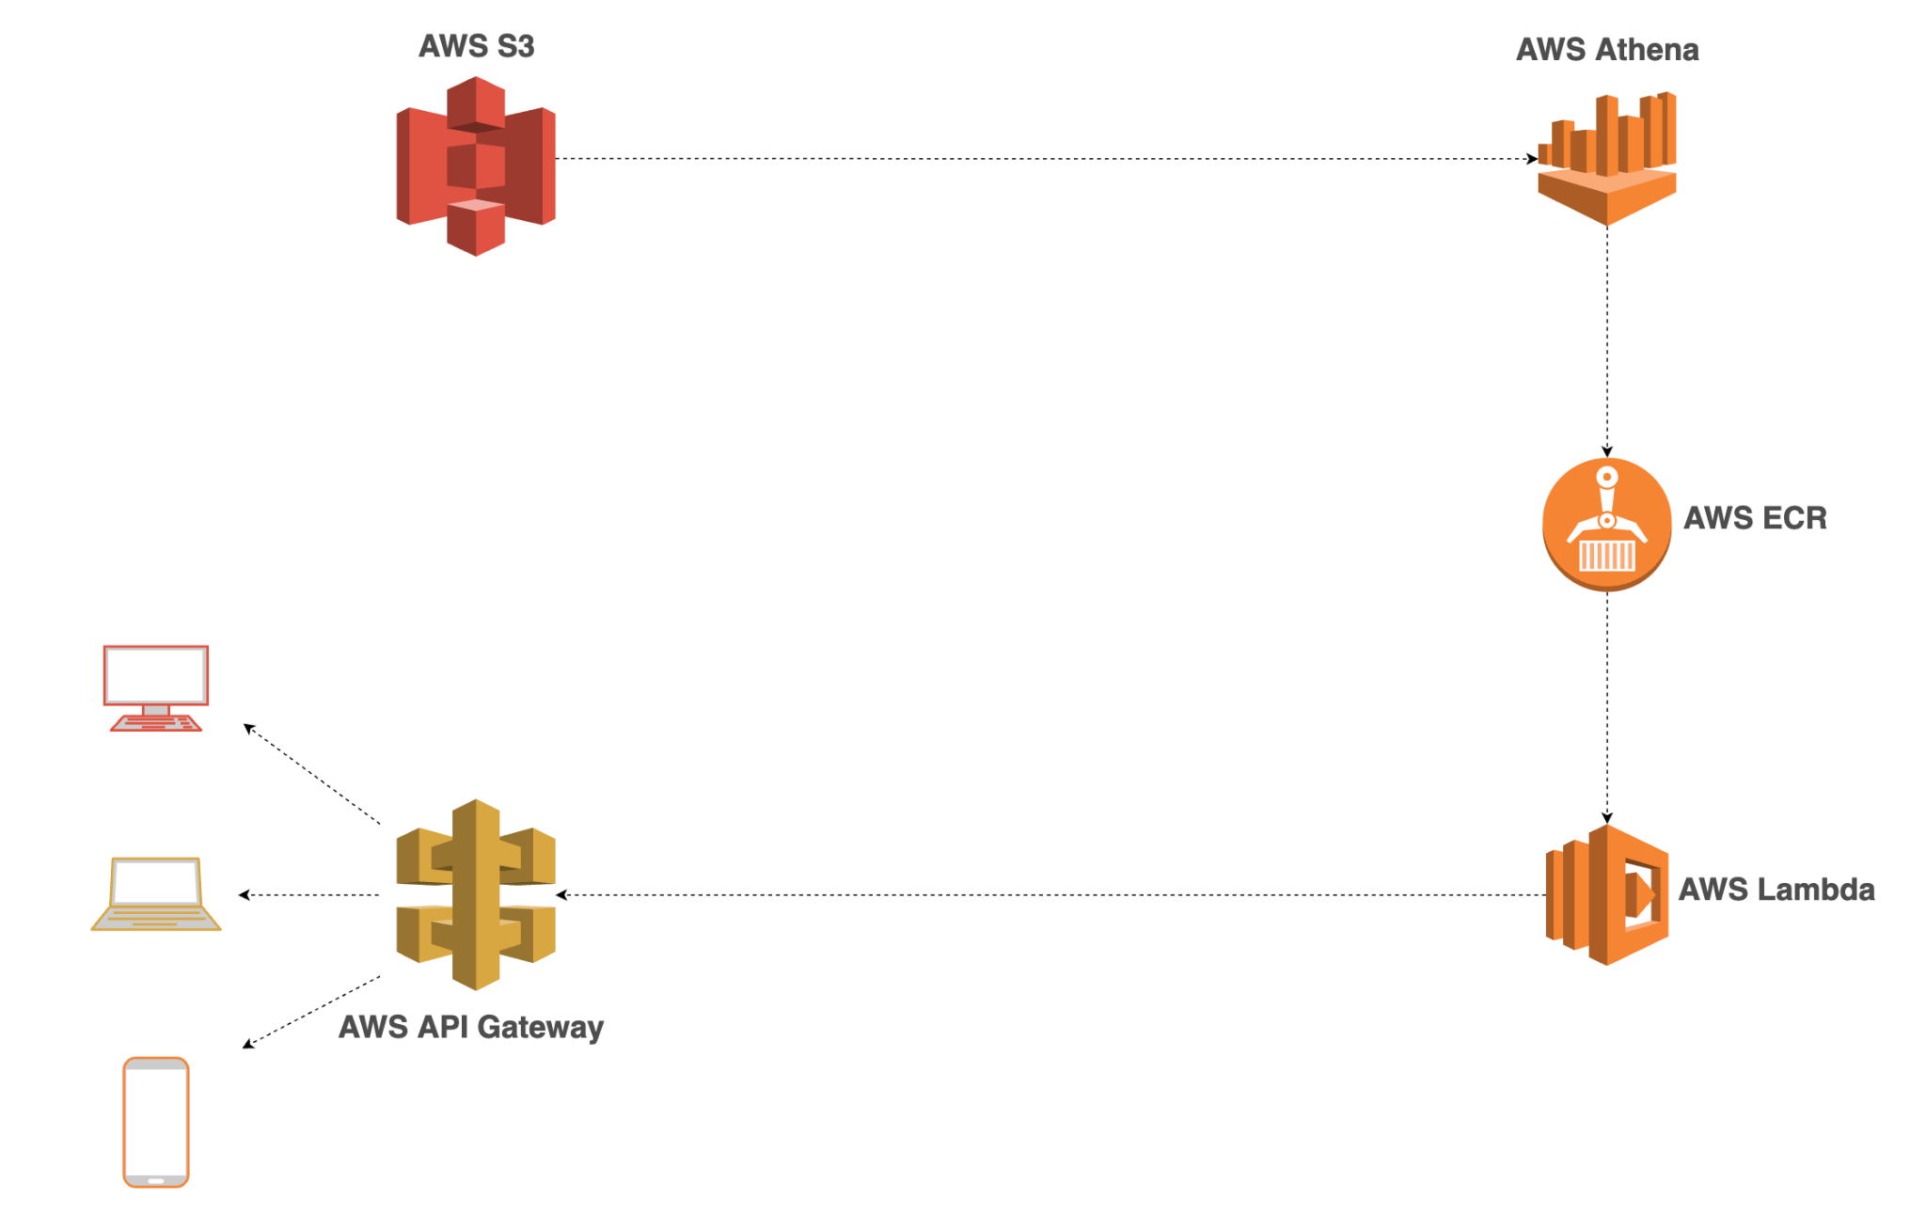
Before giving an example, let’s define some things
Notes:
https://www.serverless.com/blog/when-why-not-use-serverless
https://pauldjohnston.medium.com/when-not-to-use-serverless-jeff-6d054d0e7098

Slide 9
For the sake of time…
I’ve already populated an S3 bucket with data that we’ll retrieve here
I’ve already created our Athena query engine that we’ll use to query our data in S3
Notes:
https://www.serverless.com/blog/when-why-not-use-serverless
https://pauldjohnston.medium.com/when-not-to-use-serverless-jeff-6d054d0e7098

Slide 10
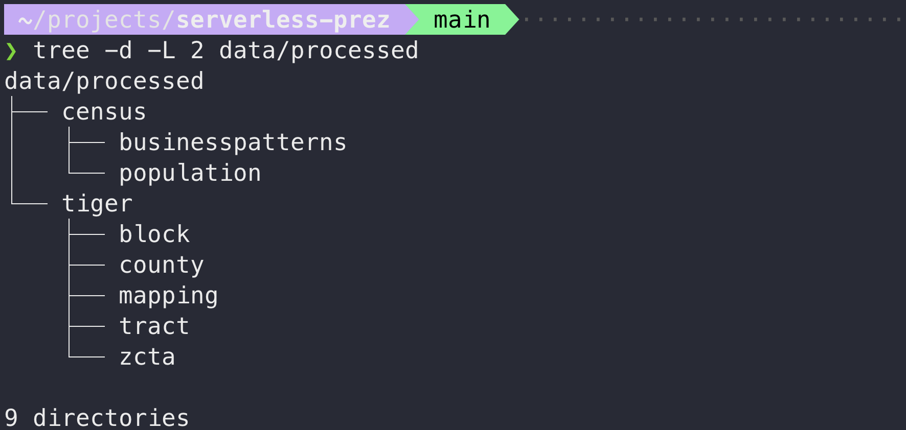
Here’s what our data in S3 looks like
Notes:
https://www.serverless.com/blog/when-why-not-use-serverless
https://pauldjohnston.medium.com/when-not-to-use-serverless-jeff-6d054d0e7098

Slide 11
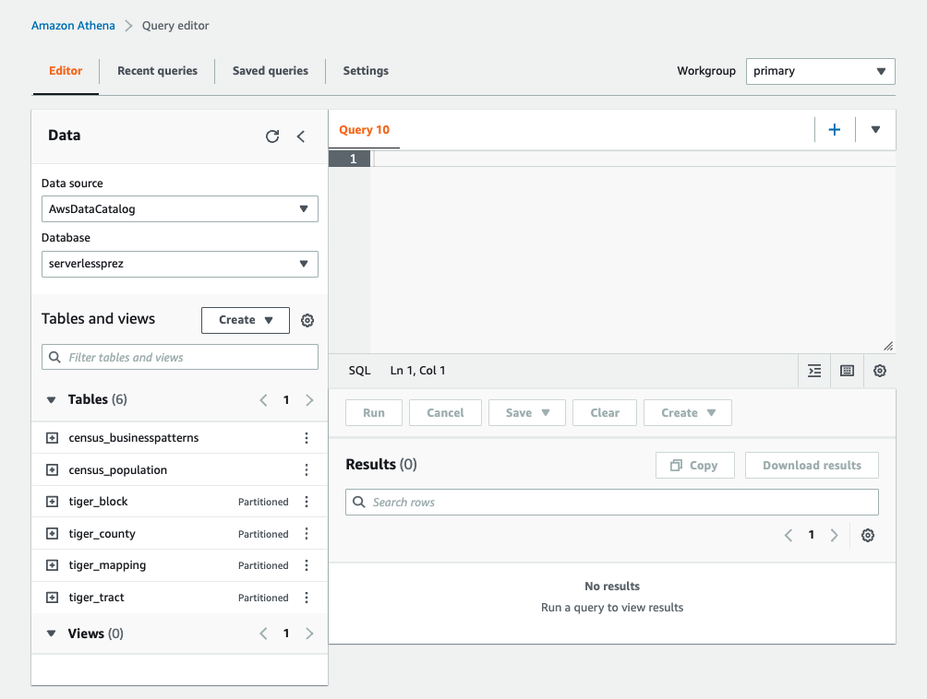
Here’s what our Athena environment looks like
Notes:
https://www.serverless.com/blog/when-why-not-use-serverless
https://pauldjohnston.medium.com/when-not-to-use-serverless-jeff-6d054d0e7098

Slide 12
Now let’s build the rest of it!
Notes:
https://www.serverless.com/blog/when-why-not-use-serverless
https://pauldjohnston.medium.com/when-not-to-use-serverless-jeff-6d054d0e7098

Slide 13
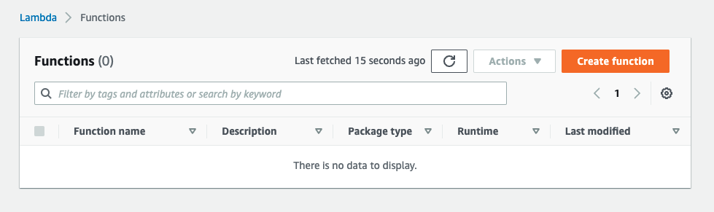
We’ll start with creating our Lambda function
Notes:
https://www.serverless.com/blog/when-why-not-use-serverless
https://pauldjohnston.medium.com/when-not-to-use-serverless-jeff-6d054d0e7098

Slide 14
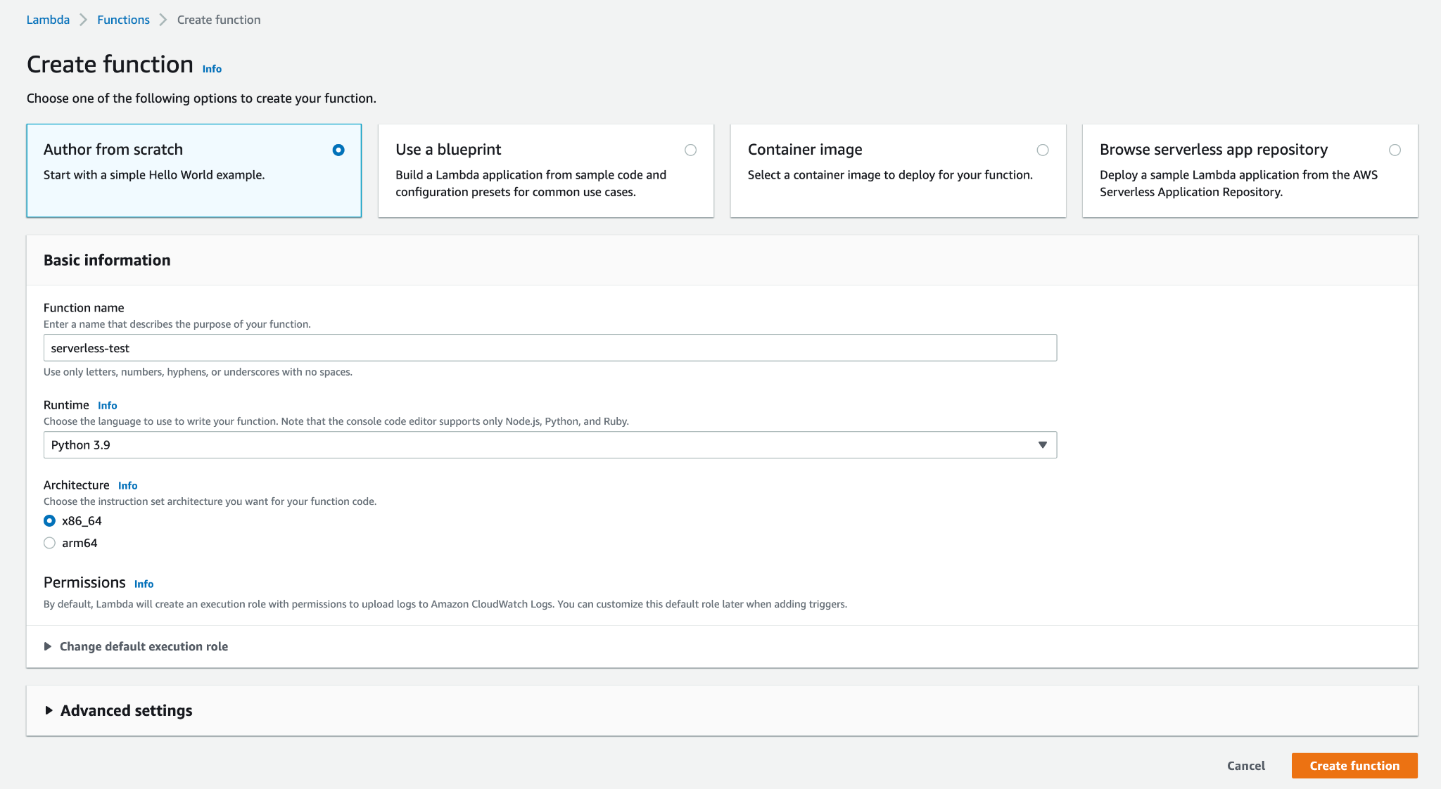
Configure and create

Slide 15
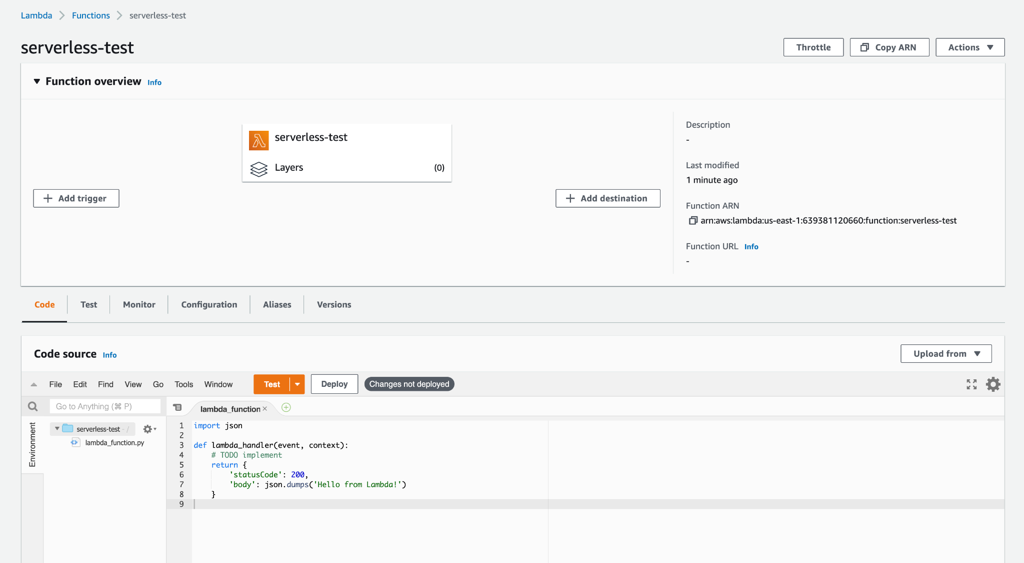
Edit function code

Slide 16
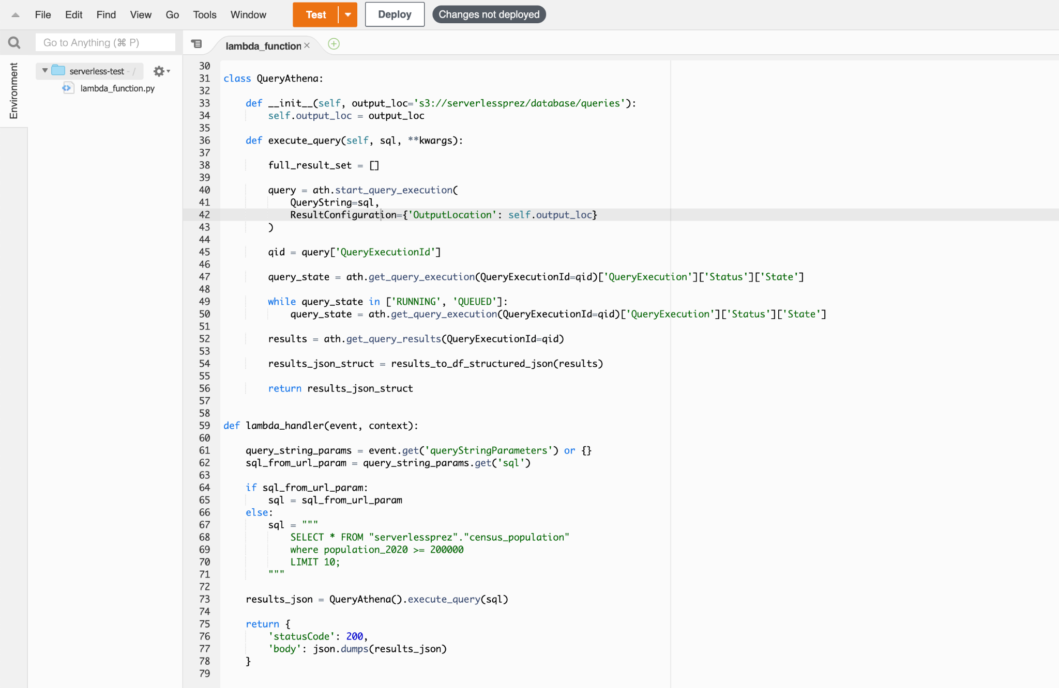
I’ll use code I’ve already written for this

Slide 17
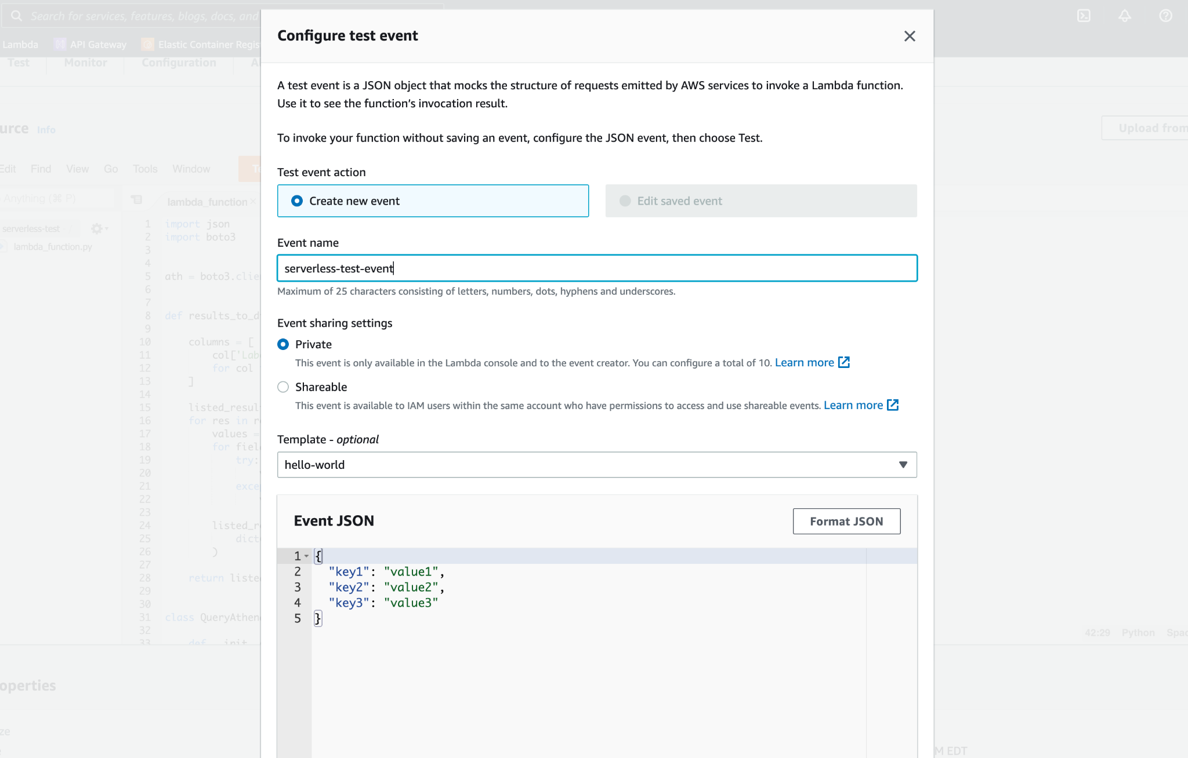
Test our Lambda function before deploying

Slide 18
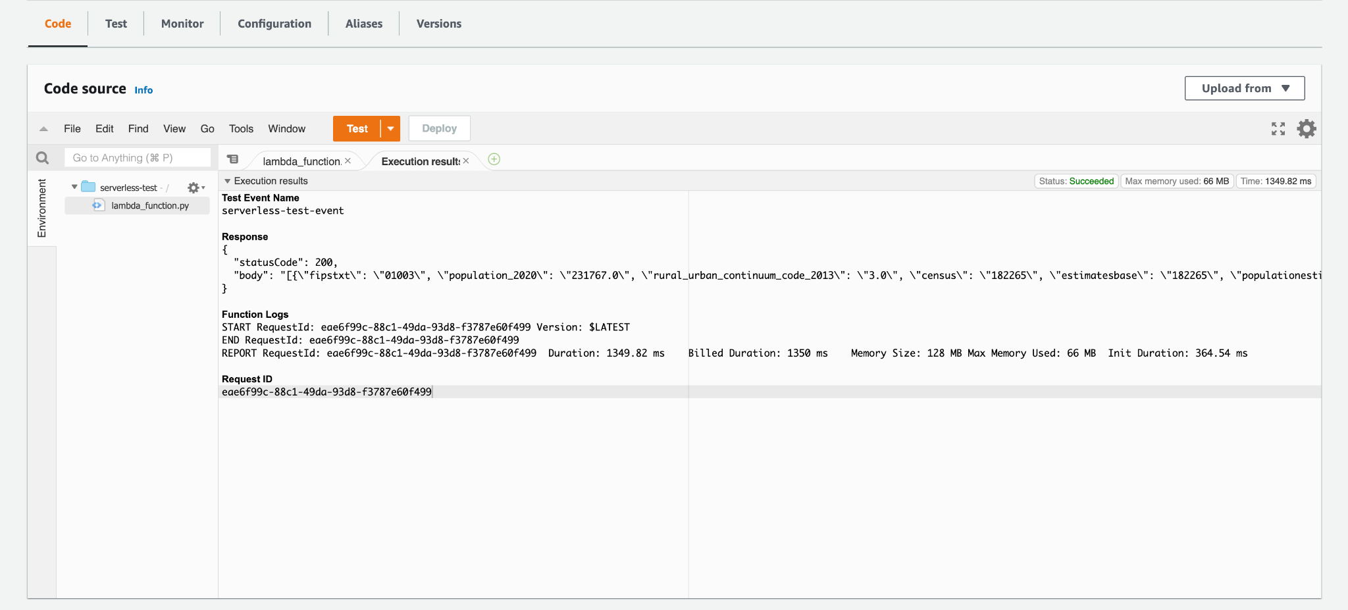
It works!

Slide 19
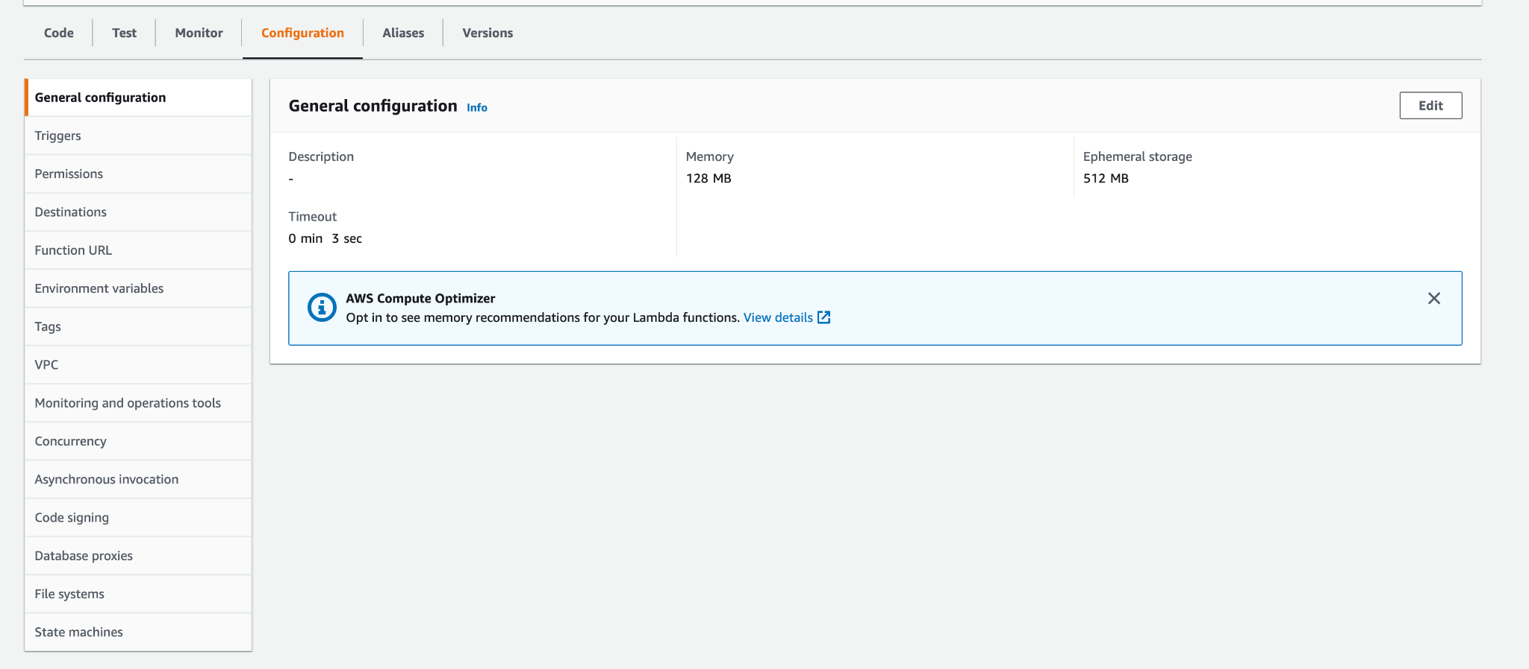
Now let’s extend the timeout and memory

Slide 20
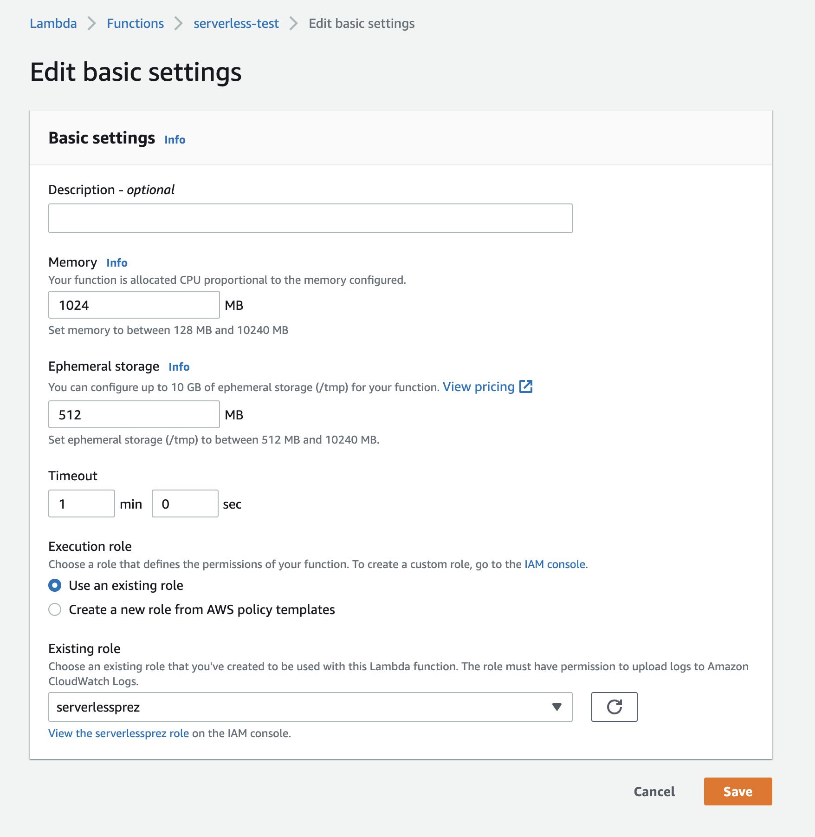
Now let’s extend the timeout and memory

Slide 21
Now let’s make our data accessible over HTTPS

Slide 22
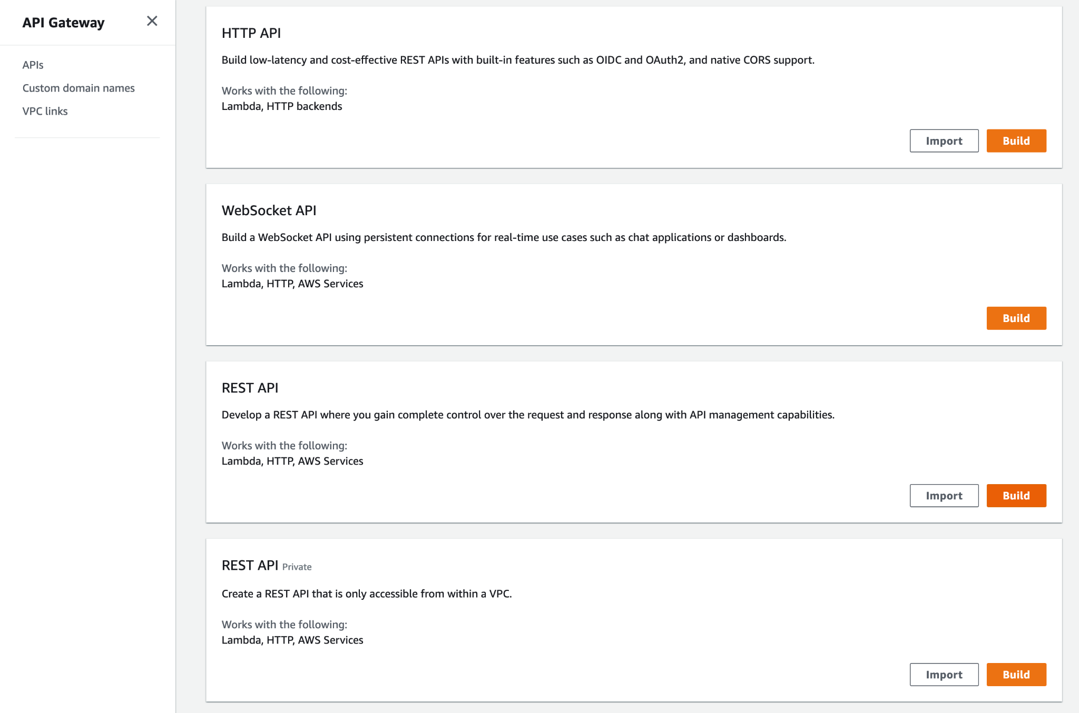
Create an API on AWS API Gateway

Slide 23
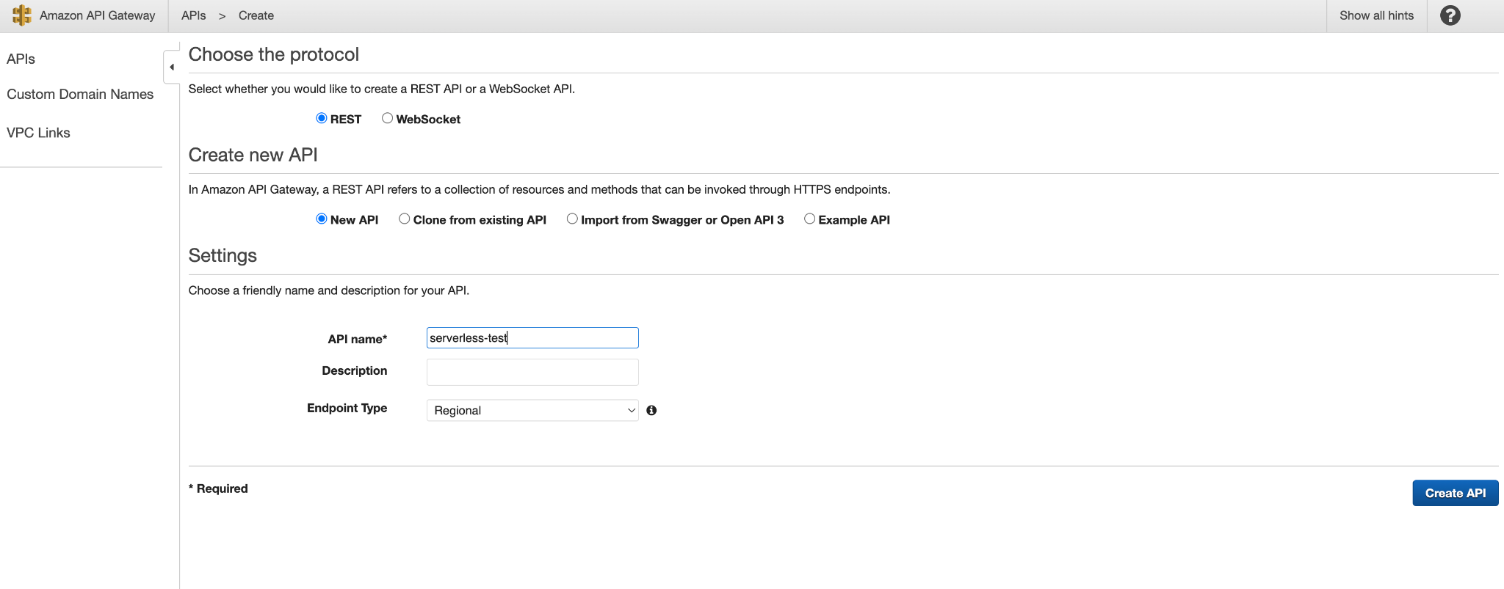
Name the API

Slide 24
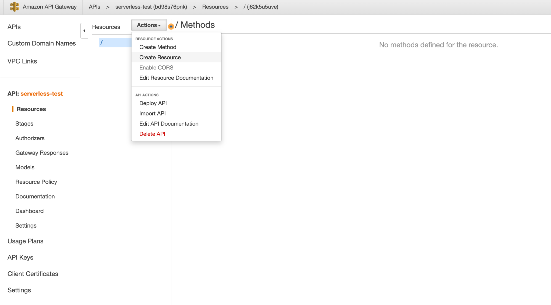
Create a resource on the API

Slide 25
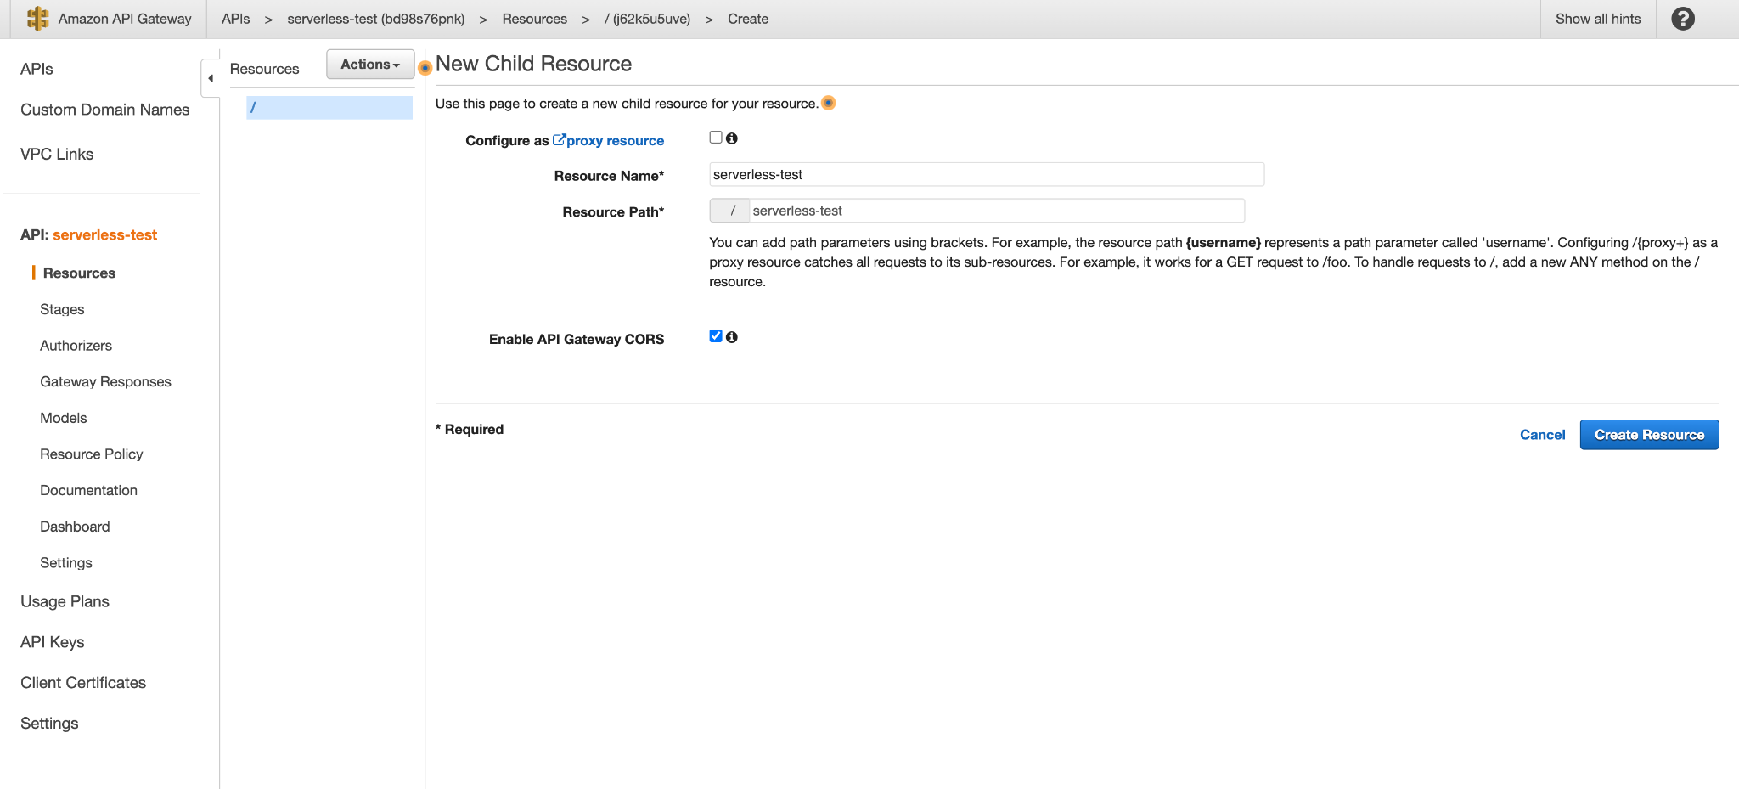
Create a resource on the API

Slide 26
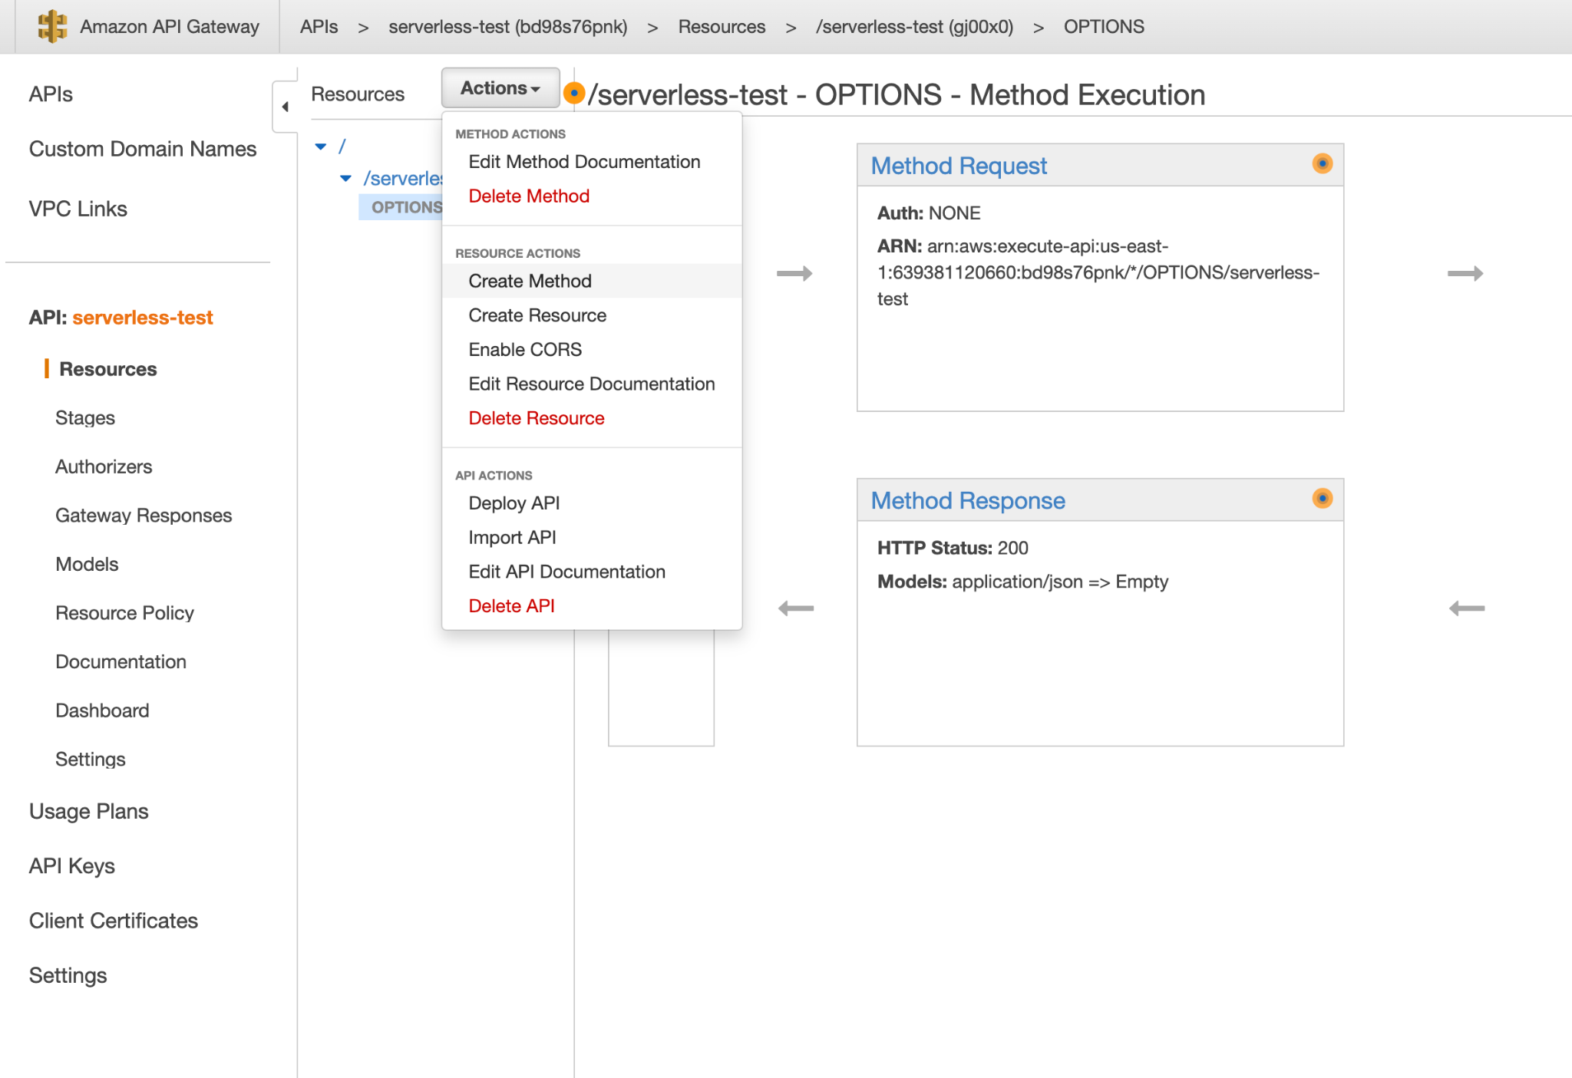
Create a method on the resource

Slide 27
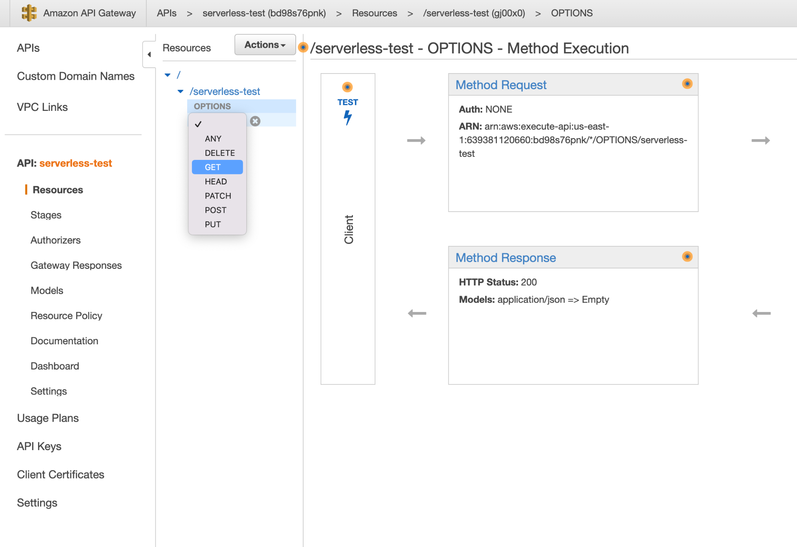
Create a method on the resource

Slide 28
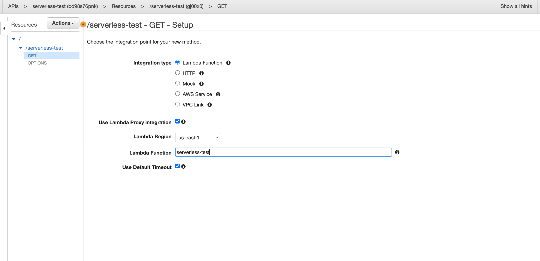
Use the Lambda function as the integration point

Slide 29
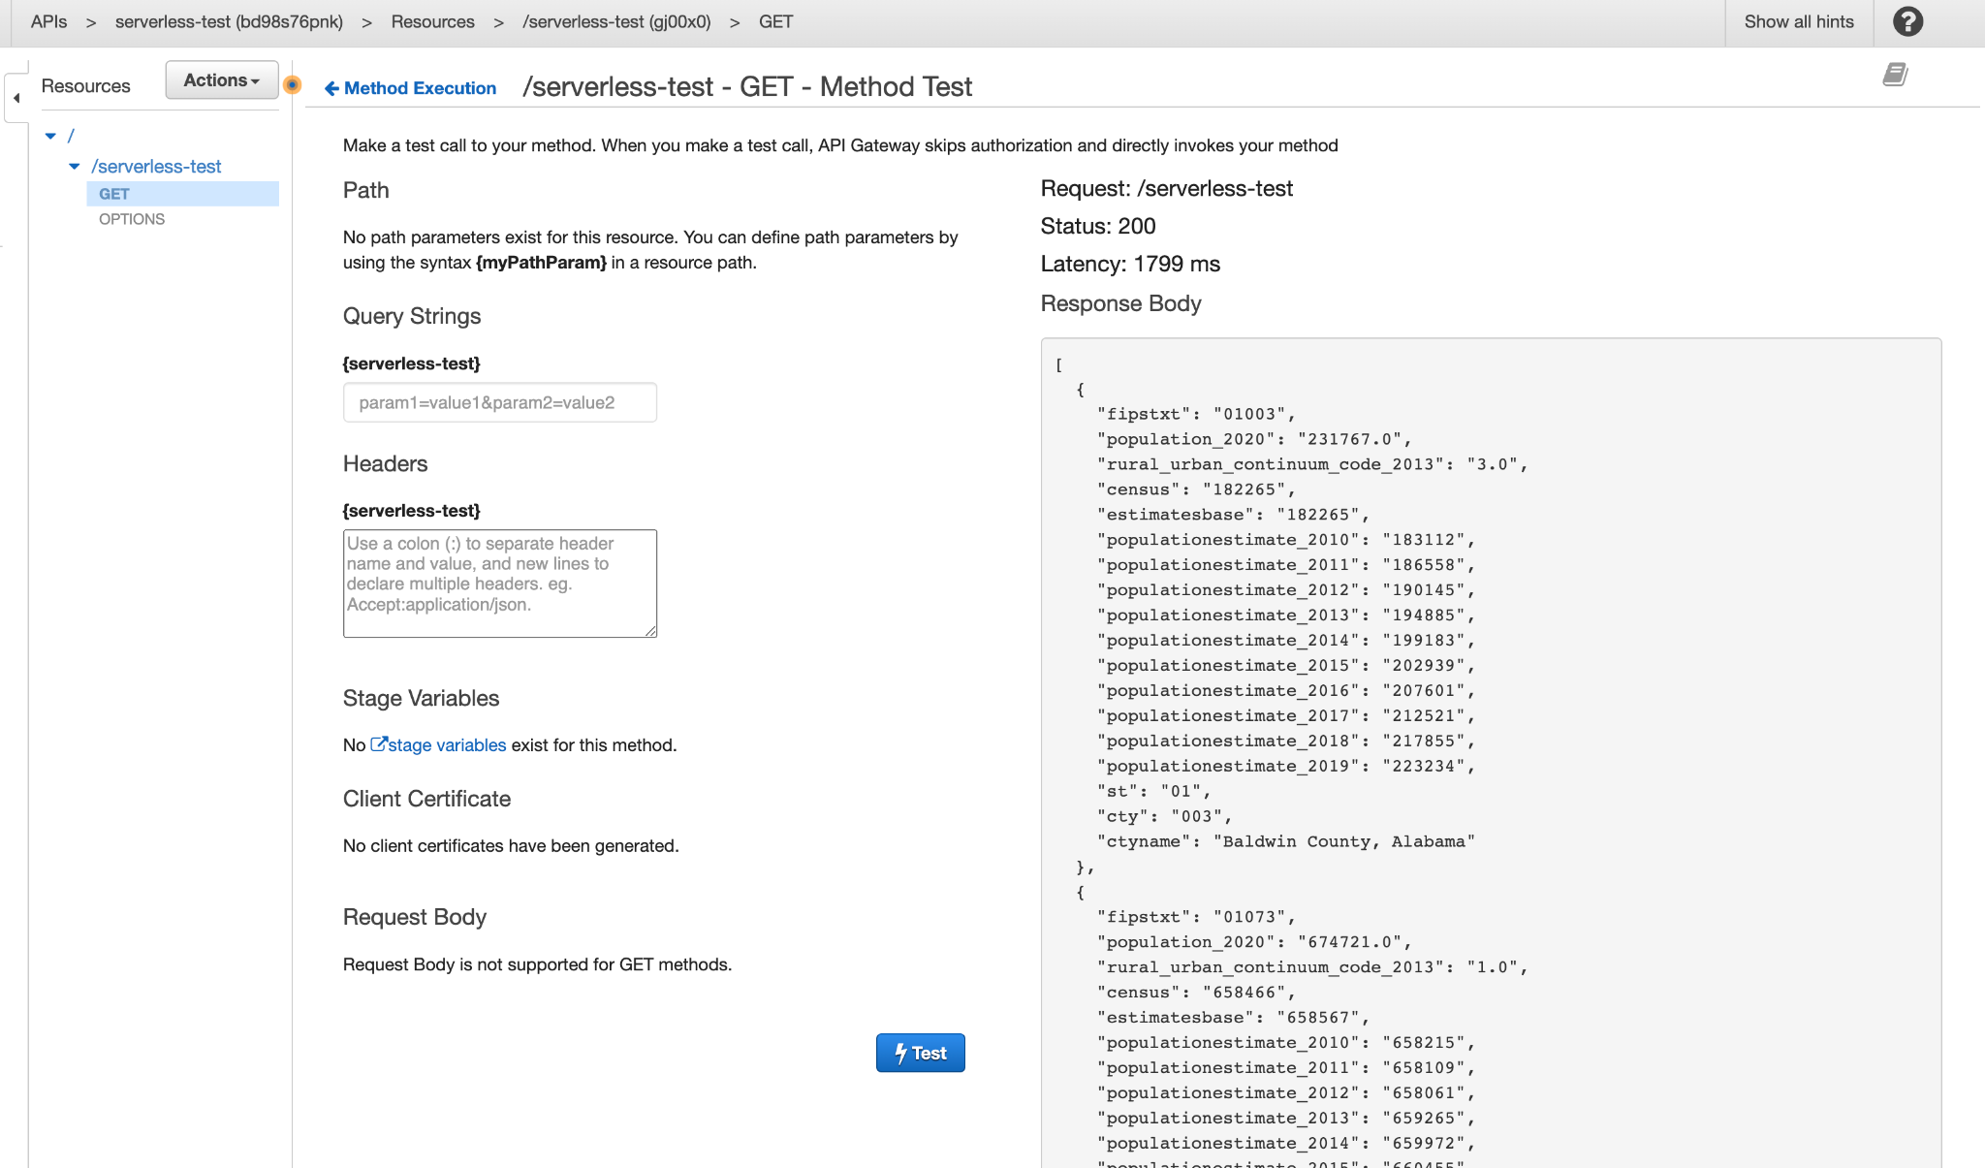
Test it out

Slide 30
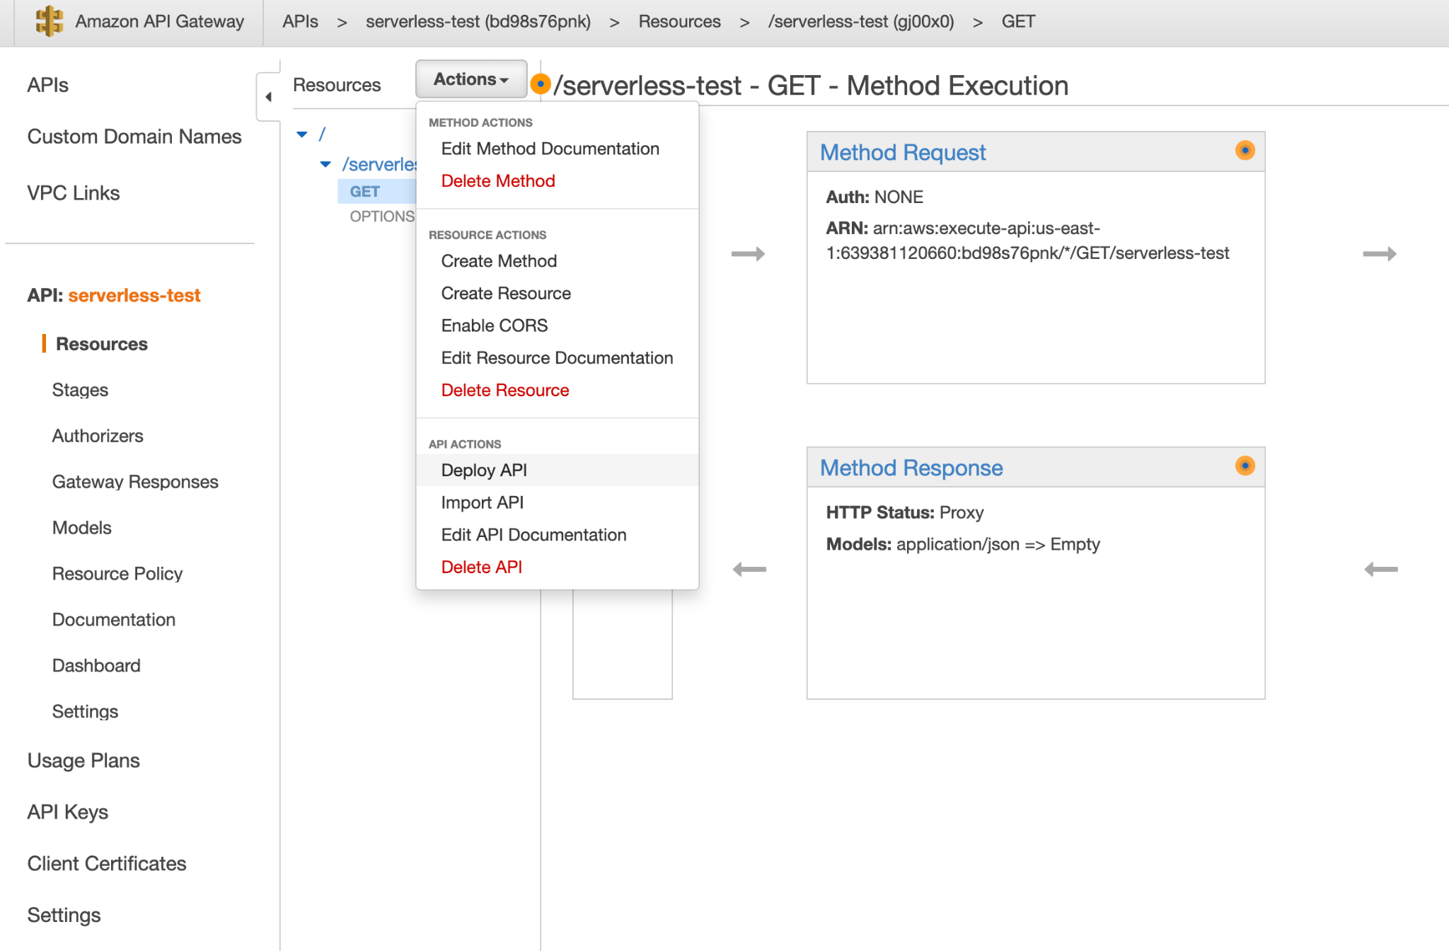
Deploy the API (so we can access it)

Slide 31
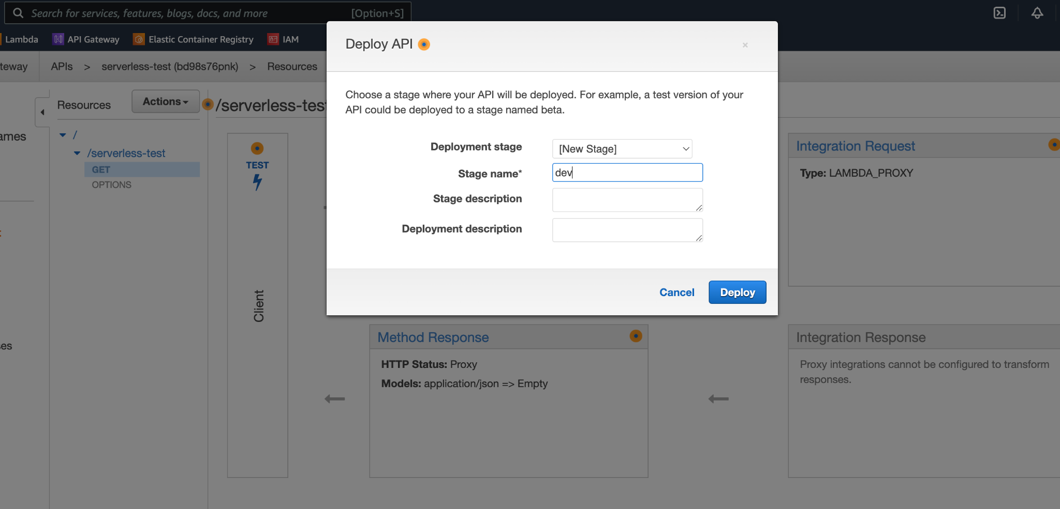
Name the deployment

Slide 32
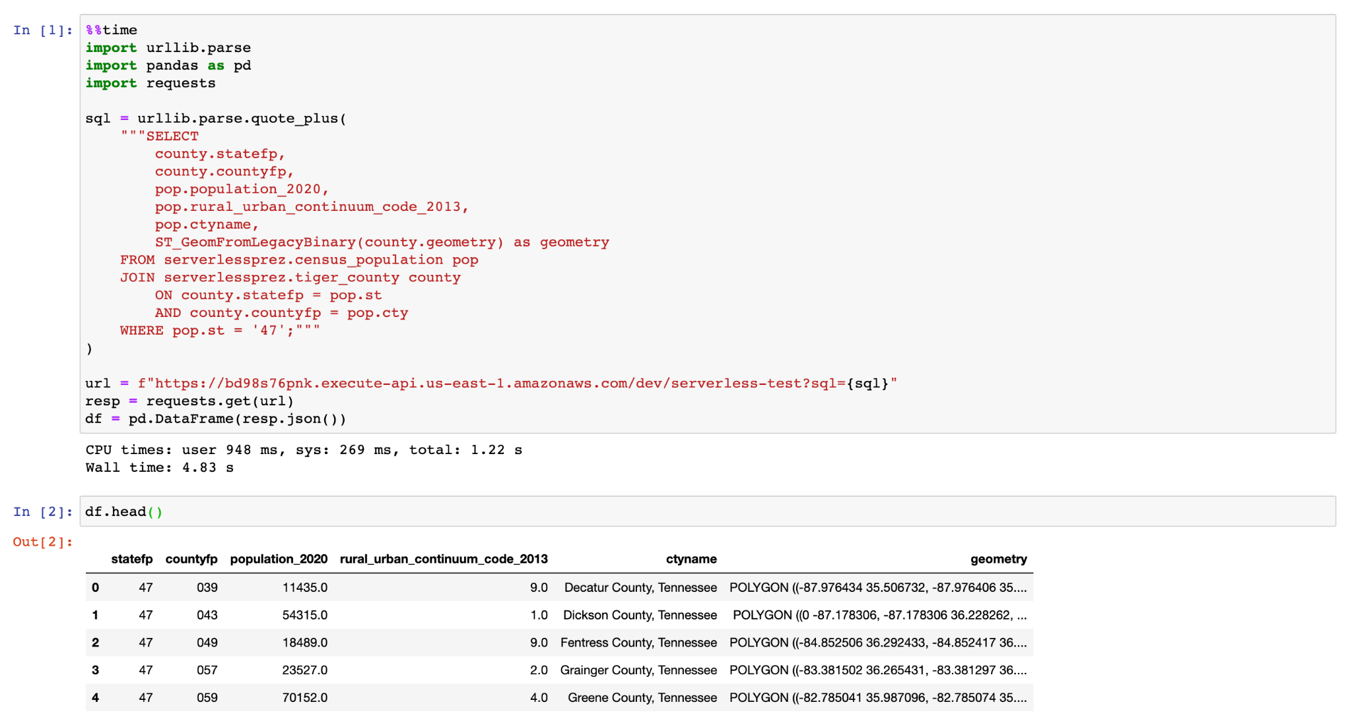
Now let’s call it from Jupyter

Slide 33
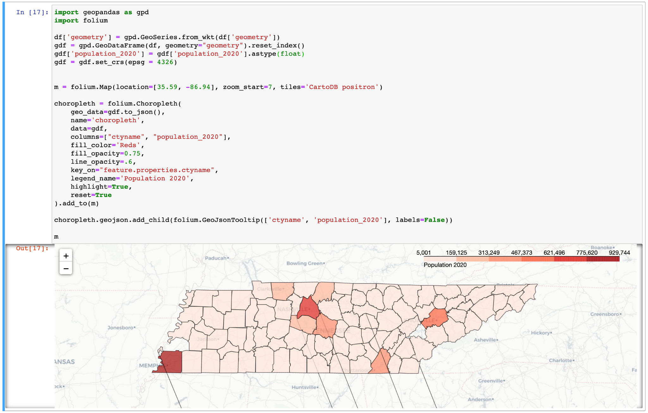
Doing more stuff with that data in Jupyter

Slide 34


Need help with a project or have questions?
Timothy Dobbins
Data Scientist|Data Engineer|Consultant
Github: github.com/tmthyjames
Linkedin: linkedin.com/in/tim-dobbins
Email: tmthyjames@gmail.com
Or scan this →
Presentation Github link: github.com/tmthyjames/serverless-prez

